Slide 1

ISMB 2020 Tutorial: Mutational Signature Analysis Common Themes and Tactics in Genomic Landscape Analyses
Ferran Muiños
ferran.muinos@irbbarcelona.org

Slide 2
0. introduction
2

Slide 3
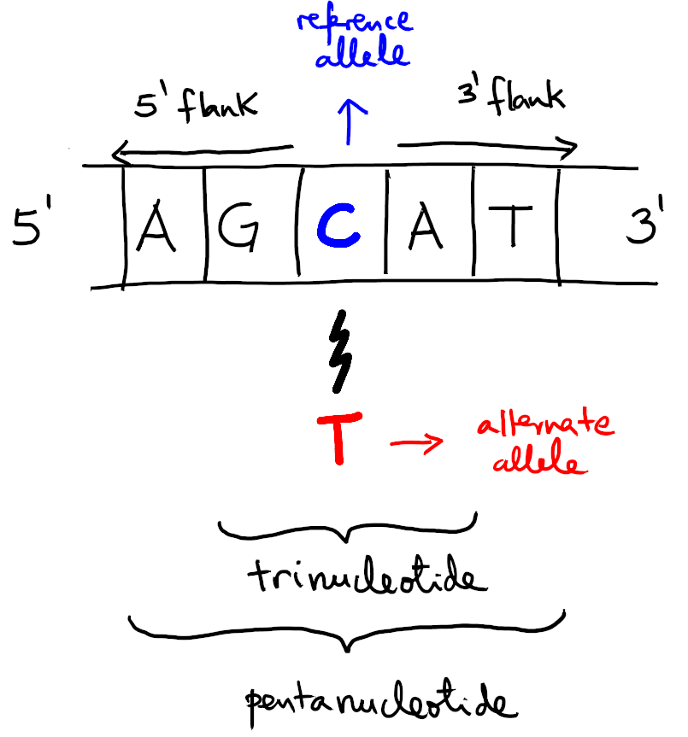
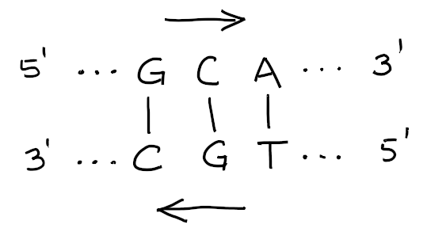
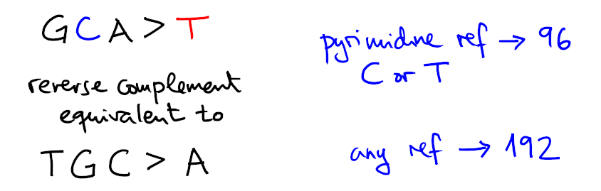
Mutation rate depends on
the nucleotide context
3

Slide 4
Why mutation rate by nucleotide context is useful?
Binning by nucleotide context allows to break down mutagenesis into common mutagenesis patterns known as signatures
Signatures are one step closer to a causal biological interpretation of mutations in terms of distinct (exogenous and endogenous) factors operative in the genome.
4
Notes:
The ref, flanking and alt bases are determinants of the mutation rate.
Mutational processes encoded as signatures all share one important fundamental property:
the mutation rates for each channel keep proportional, regardless of the exposure.

Slide 5
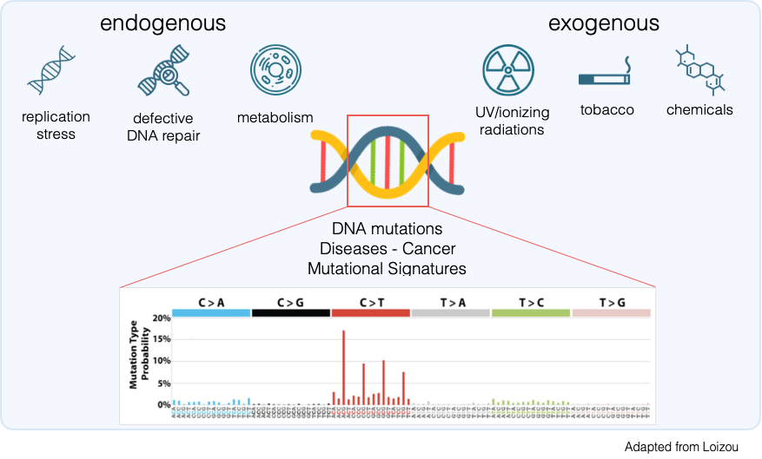
Adapted from https://loizoulab.org/research
by Carla Castignani
5
Notes:
Two examples of exogenous factors
genotoxic poisoning by
- acrylamide
- aristolochic acids

Slide 6
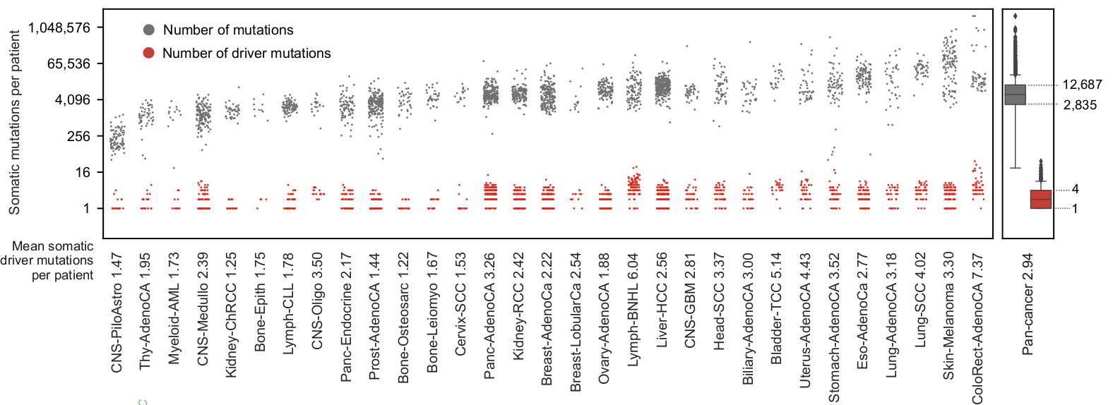
Somatic mutations are common in living cells
The study of cancer genomes has revealed that somatic cells
can accumulate up to thousands of nucleotide substitutions.
Sabarinathan, Pich et al. https://doi.org/10.1101/190330
6
Notes:
Somatic mutations (variants) reflect the history of each cell downstream from germline.
Clonal expansion (e.g. tumours) provides us a faithful snapshot of the mutational status of the founder cell(s).

Slide 7
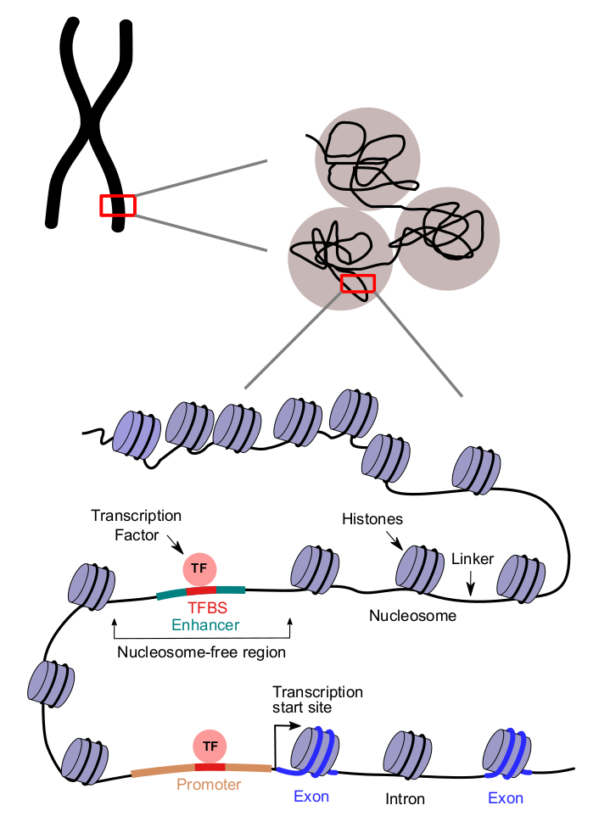
Mutation rate is not homogeneous
Mutation rate shows variability across the genome at different scales.
Some known determinants of mutation rate are related to:
- gene expression
- replication timing
- DNA-bound TF
- nucleosome positioning
- histone modifications
- transient non-B-DNA
7

Slide 8
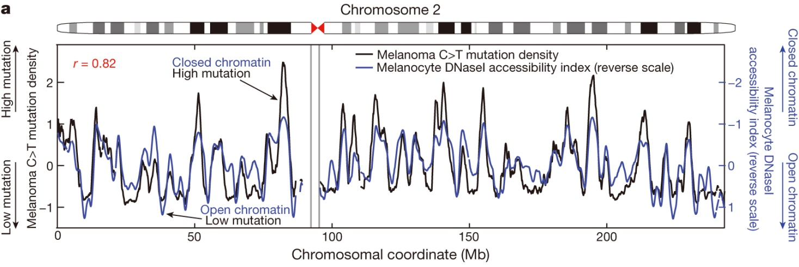
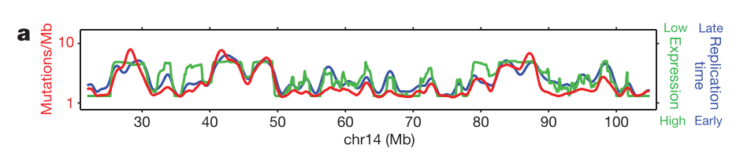
Mutation rate is not homogeneous
Polak et al. doi:10.1038/nature14221
Lawrence et al. doi:10.1038/nature12213
8

Slide 9
Session Goals
- Data (counts) → Spectra (probabilities)
- Spectra → Site-by-site mutation rate
- Mutation rate → Mutational heterogeneity
- Breaking down mutations
- The use of spectra similarity
- Review supplementary code
10

Slide 10
1. from frequencies to probabilities

Slide 11
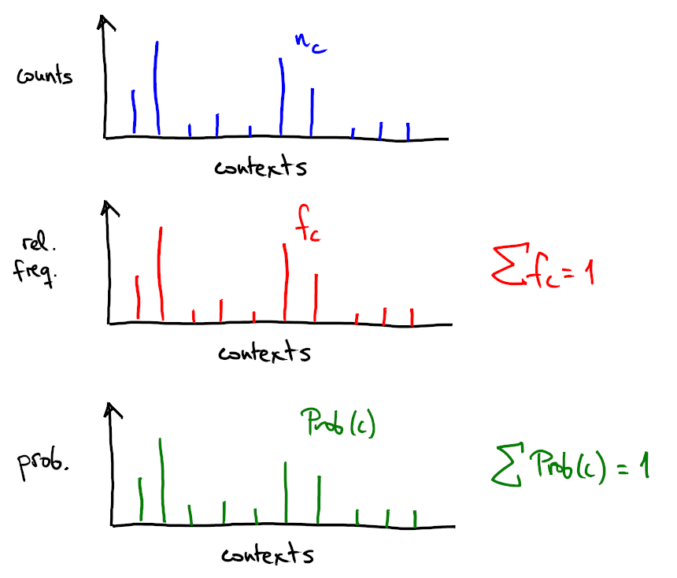
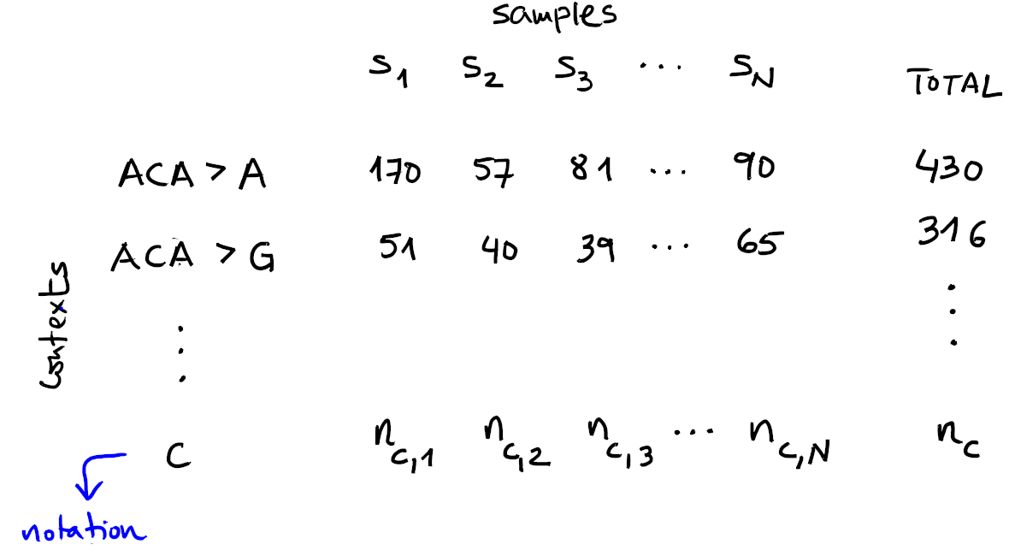
Mutation Count Data
11

Slide 12
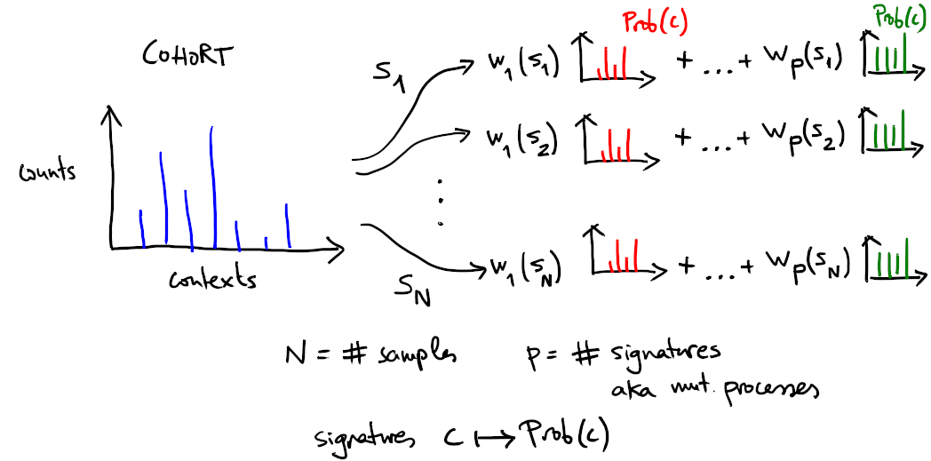
Deconstruction and fitting
12
Notes:
The profile of counts is a linear mixture of universal profiles known as signatures
The weights are also known as exposures, because they represent the expected no. mutations attributable to signature.
Profiles are our fundamental object of study.

Slide 13
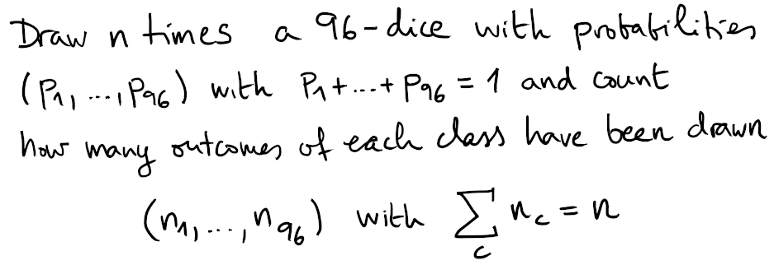
Observed frequencies are not the
true underlying probabilities
Multinomial model
13
Notes:
Frequencies estimate the probability to draw mutations with some context from a specific sequencing experiment

Slide 14
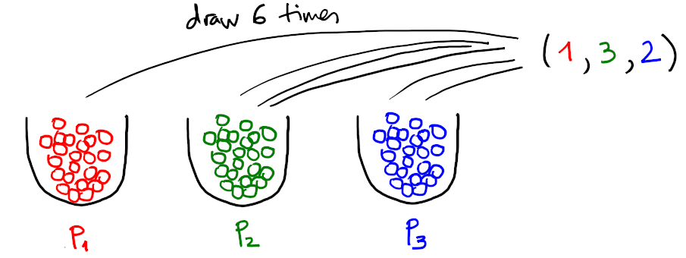
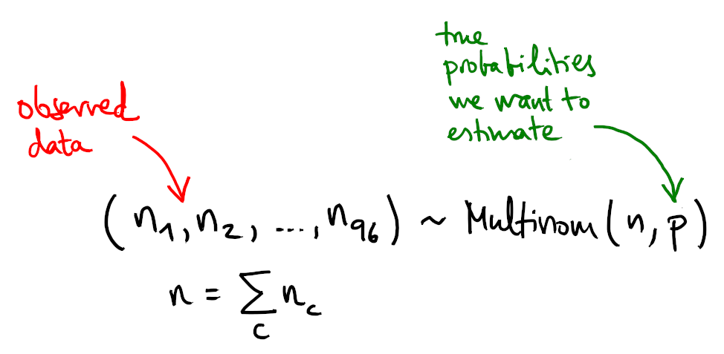
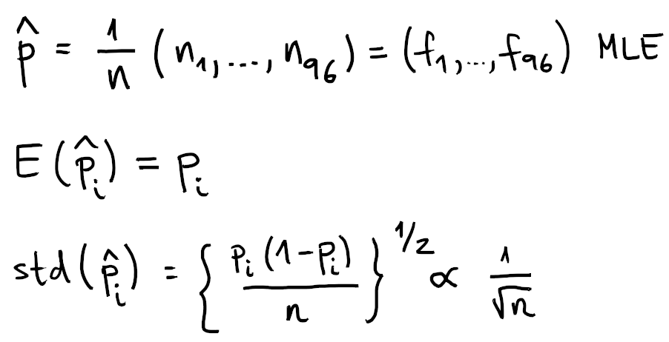
Estimating probabilities with MLE
14

Slide 15
Estimating probabilities: low counts
Maximum Likelihood Estimation (MLE) is a reasonable choice when high counts...
…but sometimes we get low counts and we still want to say something about context probability at sequencing
what to do?
15

Slide 16
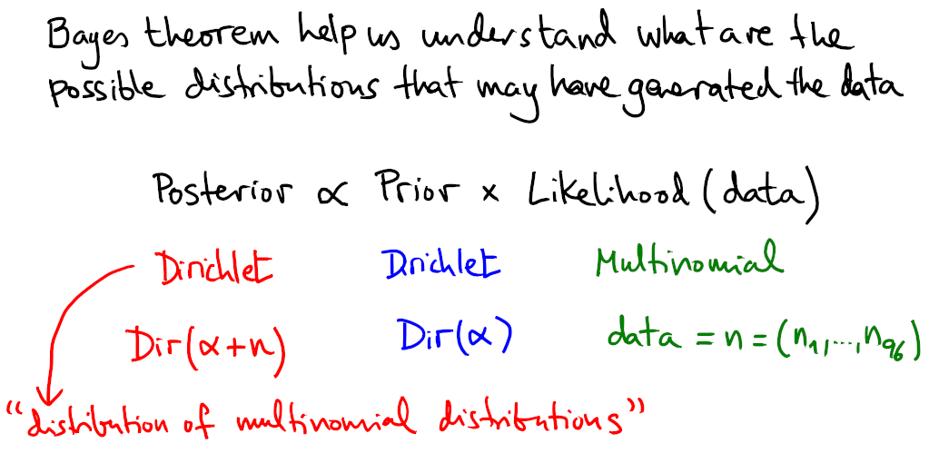
Estimating probabilities: pseudo-counts
16
Notes:
But MLEs can be misleading, particularly with sparse data.
There are some sensible choices to moderate (regularize) the estimation: Dirichlet prior.
Dummy example

Slide 17
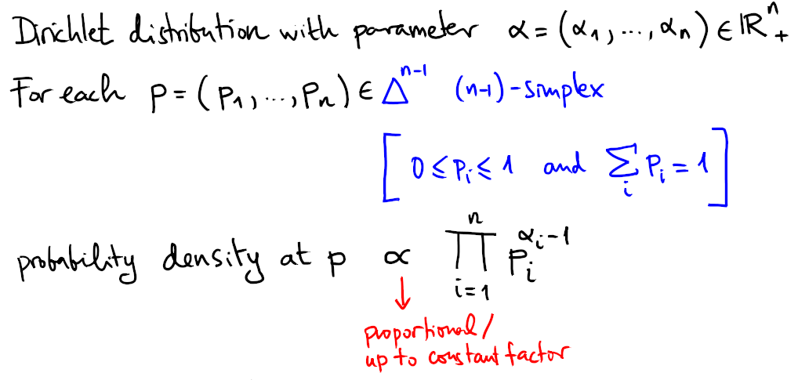
Estimating probabilities: pseudo-counts
Dirichlet distributions can be thought of as one particularly simple family of distributions of multinomial distributions
17
Notes:
Analogy between Dirichlet and distribution over the space of ways to break a stick.

Slide 18
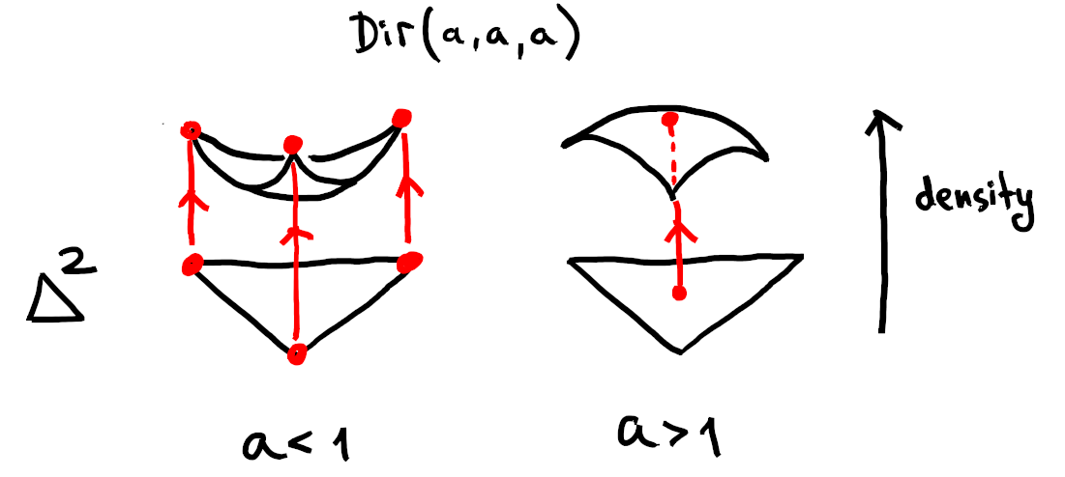
Estimating probabilities: pseudo-counts
18

Slide 19
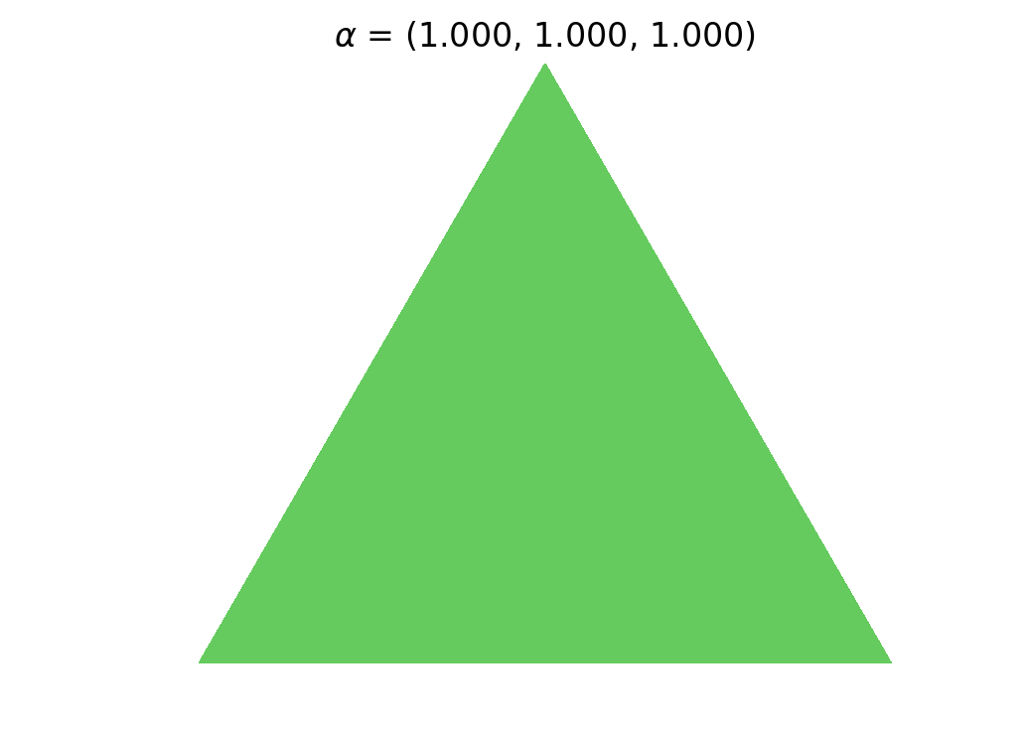
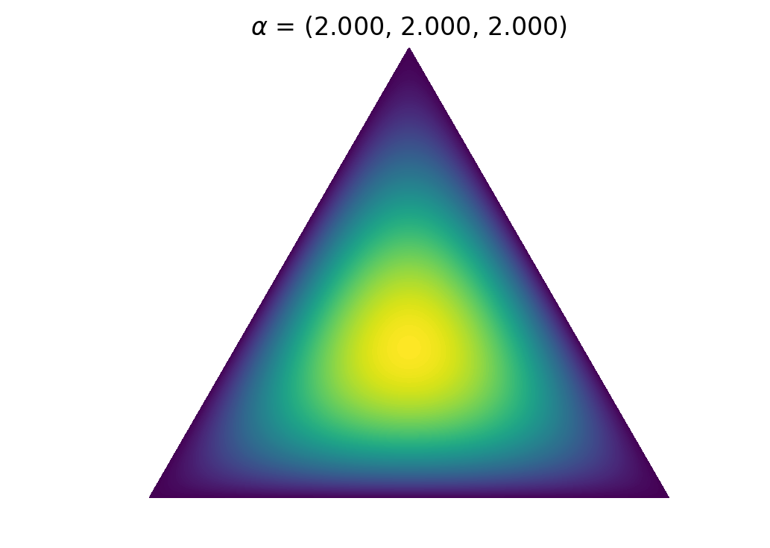
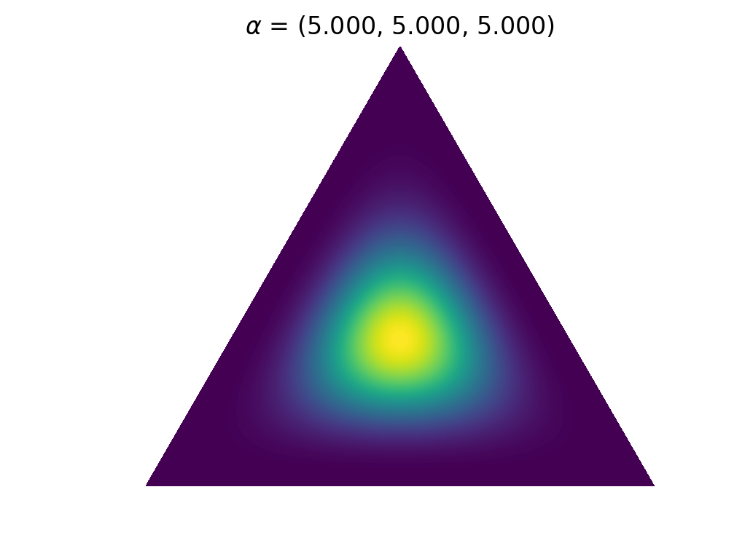
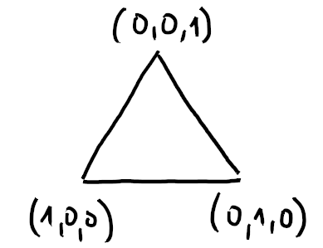
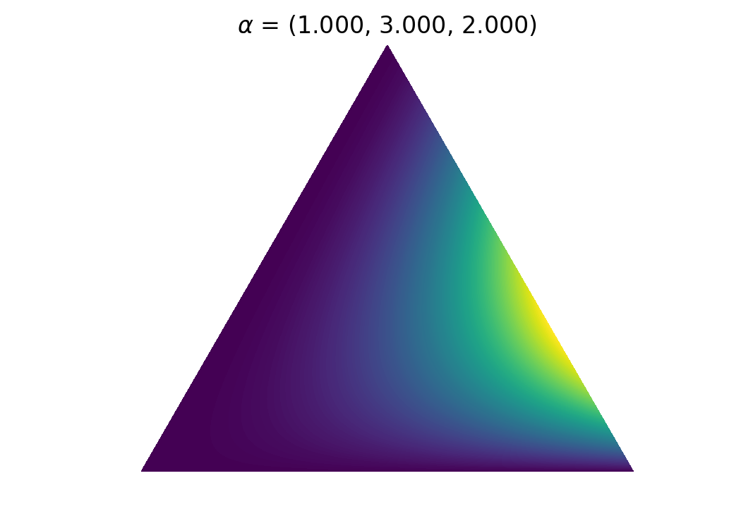
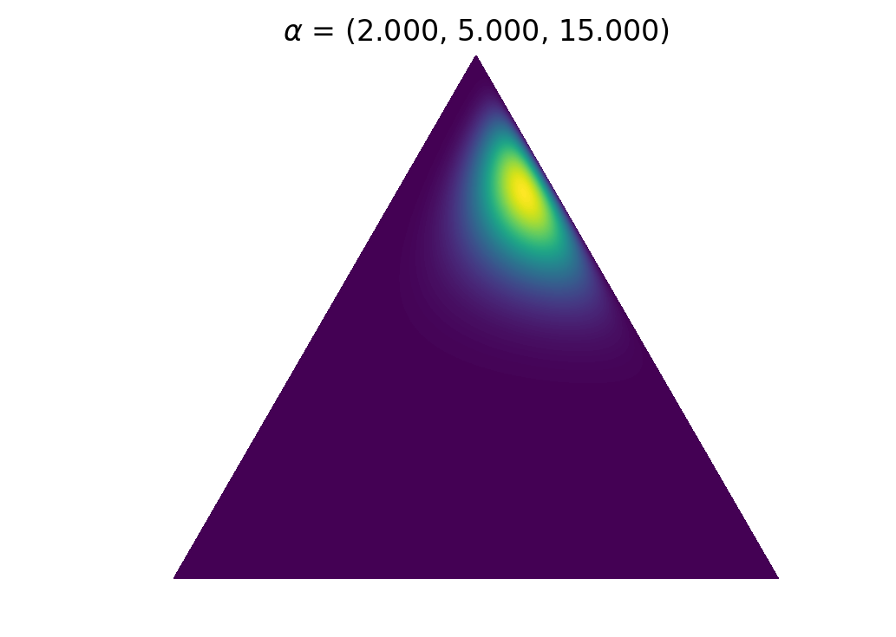
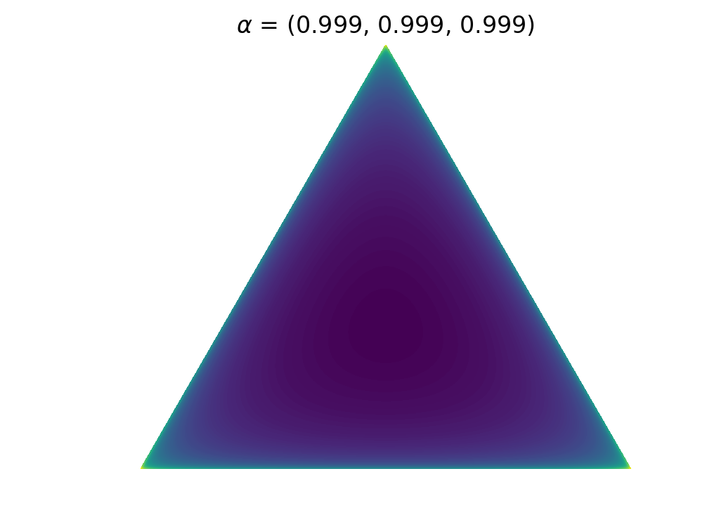
Dirichlet distribution on 2-simplex
19

Slide 20
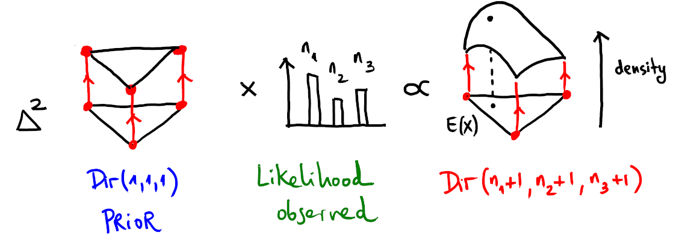
Estimating probabilities: pseudo-counts
20

Slide 21
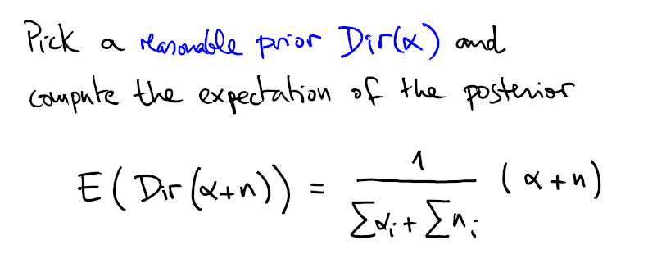
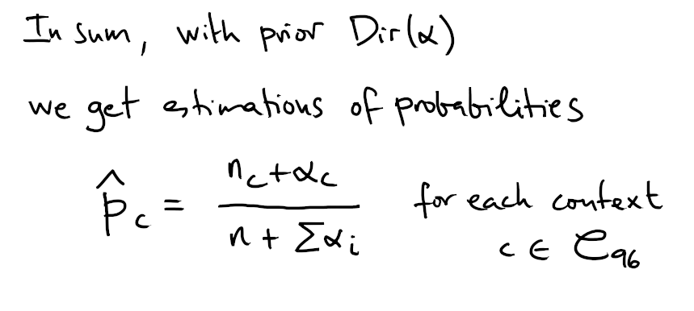
Estimating probabilities: pseudo-counts
21

Slide 22
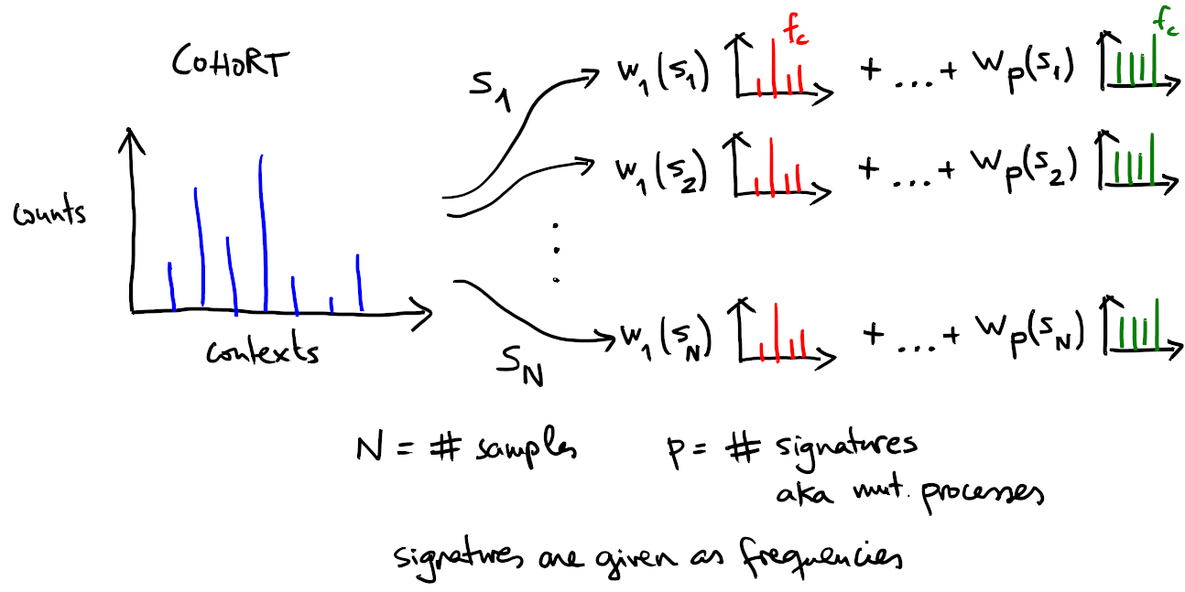
In practice signature fitting works as regularization trick
22
Notes:
Imagine sample N has few mutations (in particular a lot of zeros) but we still want to carry out inference of some kind on its mutation rate.
By fitting we can provide a plausible decomposition of the sparse set, which leads to well defined frequencies for each context.

Slide 23
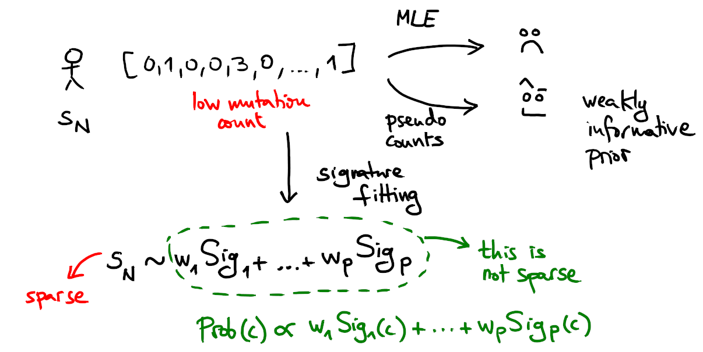
In practice signature fitting works as regularization trick
23

Slide 24
A practical note on probability
When discussing probabilities, it is often a waste of time not to have a concrete underlying random experiment in mind.
24

Slide 25
2. site specific mutation rate
Notes:
Flat mutation rate:
Take the mutation burden observed in a sample and “spread” it across possible mutations proportionally to the conditional probabilities.
Given regions we can then compare expected exposure with observed exposure. Exon-vs-Intron mutation rate.
Locally flat, neutral mutation rate:
Compute expected silent burden across the canonical transcriptome and extrapolate mutation rates (ENCODE covariates, dNdScv).

Slide 26
What do those frequencies and probabilities mean?
There are two main “forces“ that shape the spectrum inferred from our sequencing experiment:
1) site-by-site mutation rate
2) [trinucleotide] content of the region sequenced
If we correct for the content, what are we left with?
26
Notes:
Frequencies estimate the probability to draw mutations with some context from a specific sequencing experiment
Formally, expression of the error and underlying assumptions
Dummy example

Slide 27
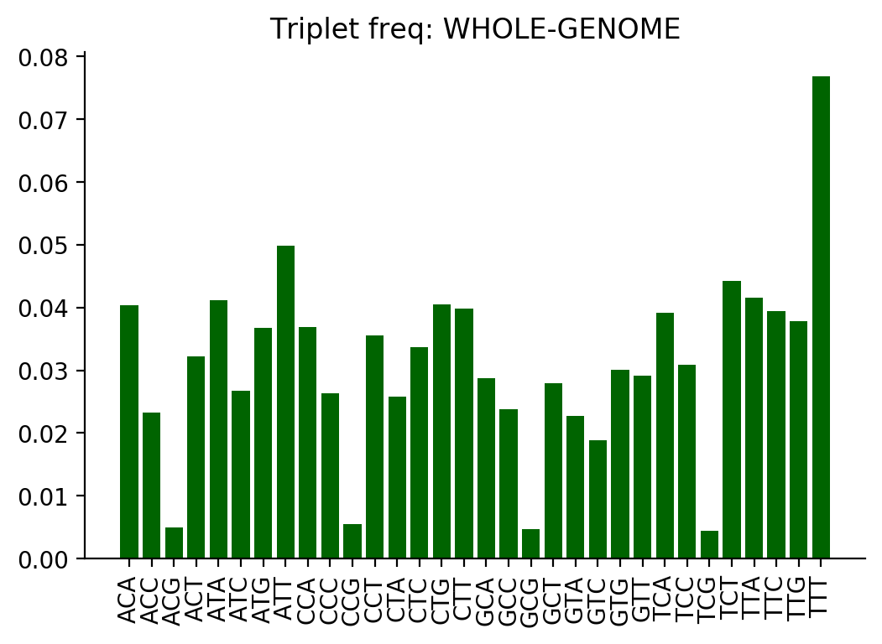
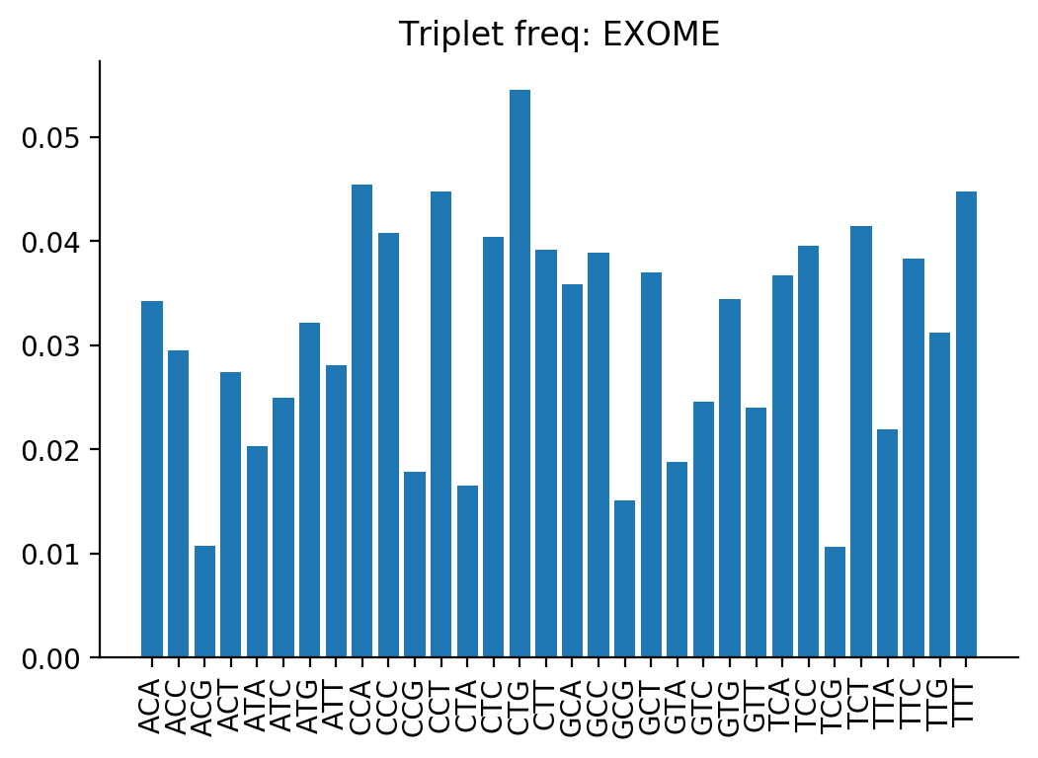
Whole genome and exome:
trinucleotide content
27

Slide 28
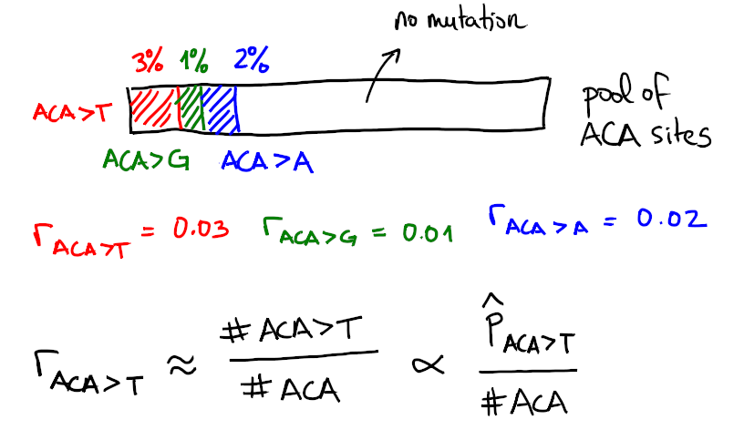
Flat model of site-by-site mutation rate
28
Notes:
What is the mutation rate?
We can reason in terms of the mutation rate without knowing it exactly.
REAL mutation rate depends on:
- accumulated exposure to mutagenic process (time and intensity of mutagen)
- dynamics of genetic damage accumulation and repair activity
- number of divisions of the cell
In a flat mutation rate model all this should be contained in a constant K

Slide 29
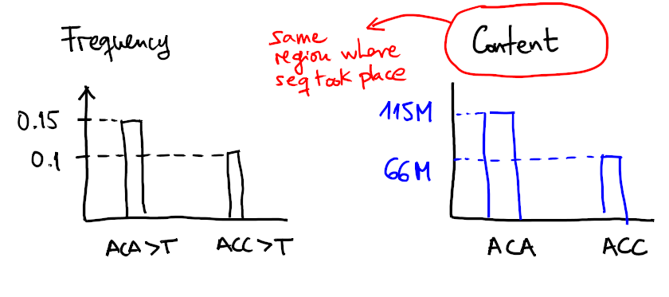
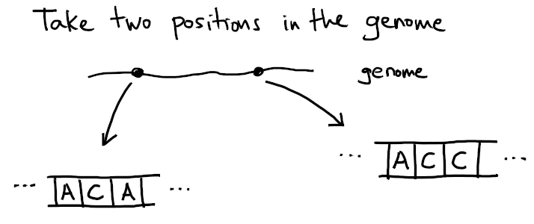
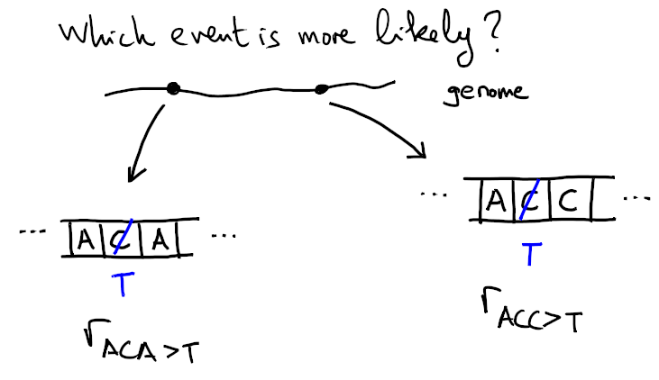
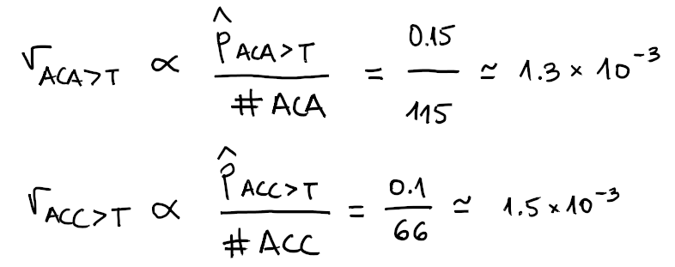
Which site is more likely to mutate?
29
Notes:
Assuming a flat operative mutational process in a genome (input are frequencies)
and neglecting the influence of any other positional covariates of mutagenesis,
let’s answer some basic questions:
1)
given 2 sites:
site1 has ACA
site2 has ACC
which is more likely to have occurred in the sequencing experiment ACA>T at site1 or ACC>T at site2?

Slide 30
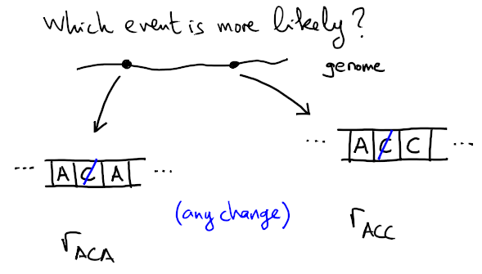
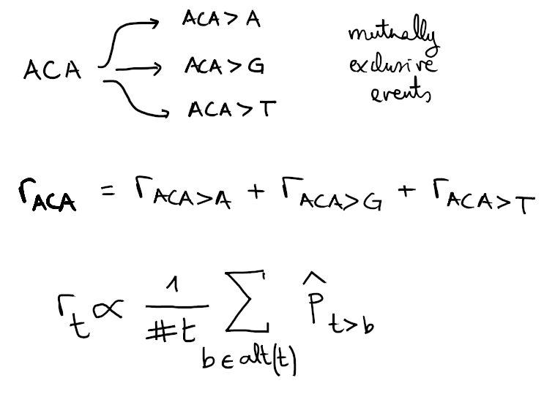
Which site is more likely to mutate?
30
Notes:
Assuming a flat operative mutational process in a genome (input are frequencies)
and neglecting the influence of any other positional covariates of mutagenesis,
let’s answer some basic questions:
2)
given 2 sites:
site1 has ACA
site2 has ACC
which is more likely to have occurred in the sequencing experiment, a mutation in site1 or in site2?

Slide 31
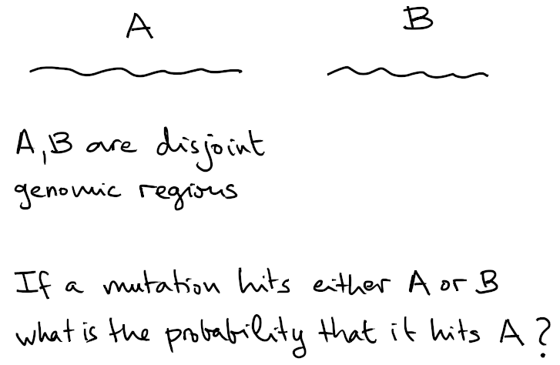
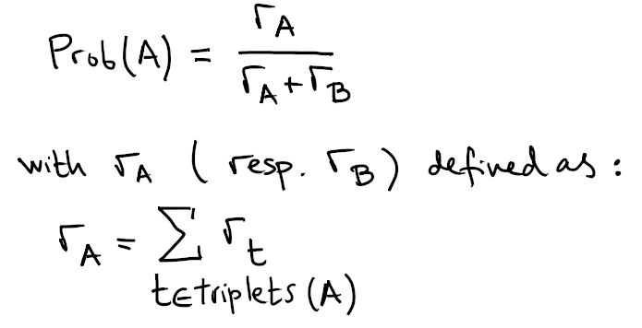
Which region is more likely to mutate?
31

Slide 32
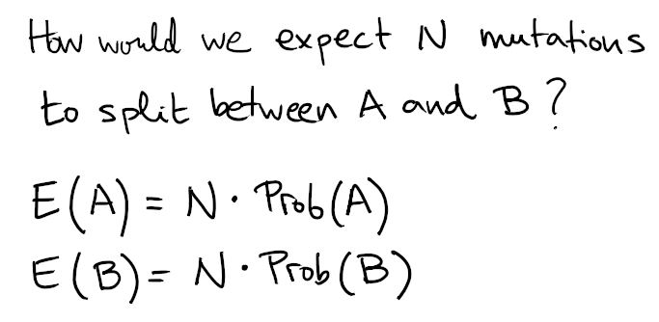
Which region is more likely to mutate
32

Slide 33
3. assessing mutation rate anomalies

Slide 34
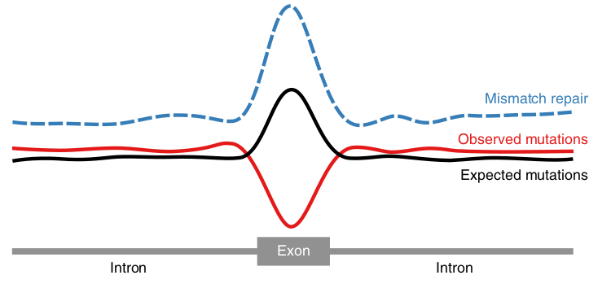
Testing differential mutation rate:
intron vs exon
Frigola et al.
doi:10.1038/ng.3991
34

Slide 35
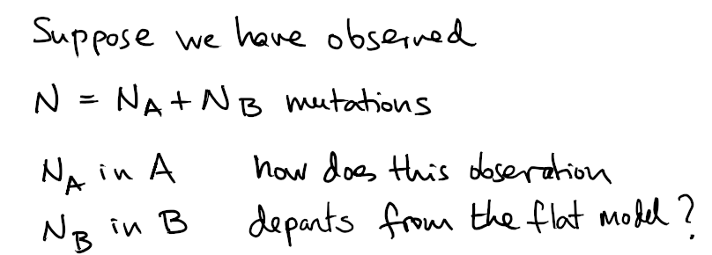
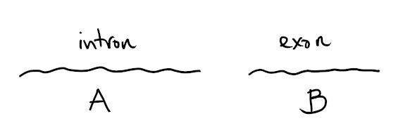
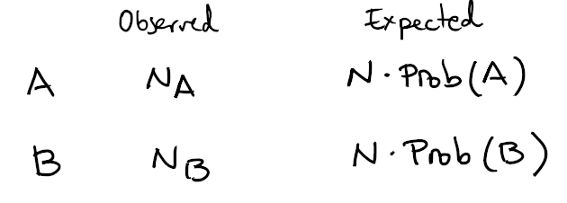
Testing differential mutation rate:
intron vs exon
35

Slide 36
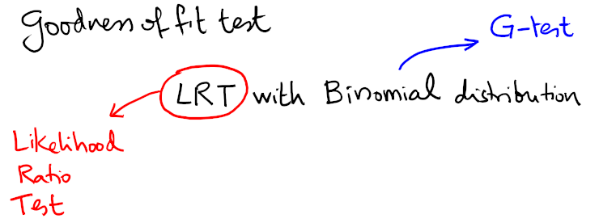
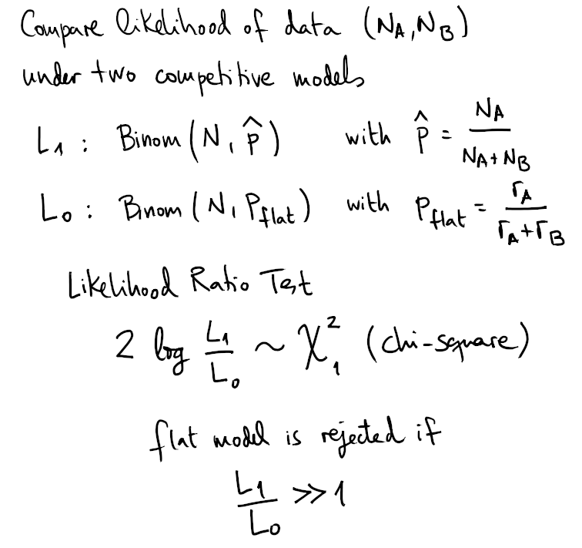
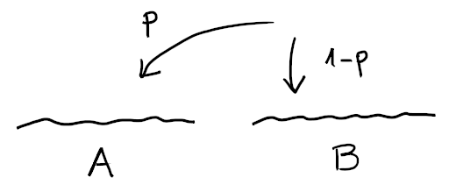
Testing differential mutation rate:
intron vs exon
36

Slide 37
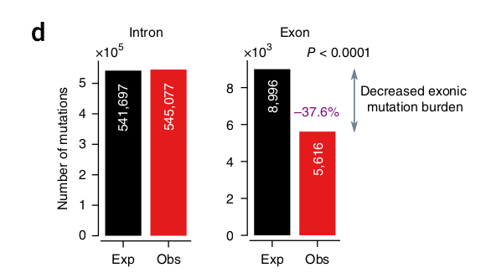

Testing differential mutation rate:
intron vs exon
Frigola et al.
doi:10.1038/ng.3991
37

Slide 38


Mutation rate models are important in the discovery of cancer genes
Martinez-Jimenez et al.
in press (Nature Reviews Cancer)
38

Slide 39

Diffusion of observed mutations: oncodriveCLUSTL
Arnedo-Pac et al.
doi: 10.1093/bioinformatics/btz501
39
Notes:
Clumping is inherent to randomness
Sometimes we need to statistically assess mutational clumps aka “clusters”, i.e. how likely it is to bring them about just by chance
Would the distribution of mutations be the same if randomly re-drawing the same number of mutations?
We need to do so consistently with mutational profiles
This idea can be extended to other forms of enrichment: functional scores

Slide 40

Locally flat model: assessing neutral mutation rates in the CDS
Learn site-by-site mutation rates:
- valid for CDS
- neutral: correct for selection
- locally flat: aware of chromatin determinants of mutation rate
Martincorena et al.
https://doi.org/10.1016/j.cell.2017.09.042
40
Notes:
Locally flat mutation rate model
1) estimate expected number of synonymous mutations in synonymous sites of a gene: negative binomial regression with epigenetic modification covariates (ENCODE)
2) spread per context

Slide 41

Neutral mutation rate in the CDS
41
Notes:
Locally flat mutation rate model
1) estimate expected number of synonymous mutations in synonymous sites of a gene: negative binomial regression with epigenetic modification covariates (ENCODE)
2) spread per context

Slide 42

Neutral mutation rate in the CDS
42
Notes:
Locally flat mutation rate model
1) estimate expected number of synonymous mutations in synonymous sites of a gene: negative binomial regression with epigenetic modification covariates (ENCODE)
2) spread per context

Slide 43



Neutral mutation rate in the CDS
43
Notes:
Locally flat mutation rate model
1) estimate expected number of synonymous mutations in synonymous sites of a gene: negative binomial regression with epigenetic modification covariates (ENCODE)
2) spread per context

Slide 44


Neutral mutation rate in the CDS
44
Notes:
Locally flat mutation rate model
1) estimate expected number of synonymous mutations in synonymous sites of a gene: negative binomial regression with epigenetic modification covariates (ENCODE)
2) spread per context

Slide 45


Stack analysis of mutation rate
45
Notes:
In view of the signature attribution inferred we now ask what is the expected fraction of mutations in context and sample that are expected to be caused by some signature.
This allows to break down individual mutations into virtual fractional mutations representing different etiologies.
Adding them up we can build a signal that can be further analysed.
Two examples: nucleosomes, UV exposure

Slide 46



Stack analysis of mutation rate
Frigola et al.
doi:10.1038/ng.3991
46

Slide 47
4. Segregated mutational landscapes
Notes:
Mutations can be broken down: virtual fractions of mutation reflecting the chances that this mutation has been originated by a given mutational process.
Specific for each sample and context.
Total exposure of a signature in a given region can be computed
Mean risk coming from a specific exposure is computed by spreading a unit burden and comparing region vs environment.
Unit risk attributable to a mutational process can be converted to effective risk is multiplied by the exposure.

Slide 48


What signature caused this mutation?
48
Notes:
In view of the signature attribution inferred we now ask what is the expected fraction of mutations in context and sample that are expected to be caused by some signature.
This allows to break down individual mutations into virtual fractional mutations representing different etiologies.
Adding them up we can build a signal that can be further analysed.
Two examples: nucleosomes, UV exposure

Slide 49



What signature caused this mutation?
49
Notes:
In view of the signature attribution inferred we now ask what is the expected fraction of mutations in context and sample that are expected to be caused by some signature.
This allows to break down individual mutations into virtual fractional mutations representing different etiologies.
Adding them up we can build a signal that can be further analysed.
Two examples: nucleosomes, UV exposure

Slide 50




Mutation rate in
nucleosome-covered DNA
Pich et al.
https://doi.org/10.1016/j.cell.2018.10.004
50
Notes:
In view of the signature attribution inferred we now ask what is the expected fraction of mutations in context and sample that are expected to be caused by some signature.
This allows to break down individual mutations into virtual fractional mutations representing different etiologies.
Adding them up we can build a signal that can be further analysed.
Two examples: nucleosomes, UV exposure

Slide 51


Decomposition of UV light exposure
Kranas et al.
unpublished
51
Notes:
In view of the signature attribution inferred we now ask what is the expected fraction of mutations in context and sample that are expected to be caused by some signature.
This allows to break down individual mutations into virtual fractional mutations representing different etiologies.
Adding them up we can build a signal that can be further analysed.
Two examples: nucleosomes, UV exposure

Slide 52
5. Assessing similarity
Notes:
Cosine similarity (geometric)
Relative entropy (how to interpret the order of magnitude)
These are pointwise comparisons, but it may also be useful to think about a random signature profile generating process and compute p-values
Such random generating processes can be e.g.
based on rearrangements or based on distributions (Dirichlet)

Slide 53

The problem of grouping samples
53

Slide 54


The problem of grouping samples
54

Slide 55


Jensen-Shannon divergence
55

Slide 56


Cosine similarity
56

Slide 57


Hierarchical Clustering Examples
Jensen-Shannon
Cosine
Kranas et al.
unpublished
ICGC Melanoma Australia Cohort
57

Slide 58






Jensen-Shannon and Cosine divergences in the 2-simplex
Centroid [1/3, 1/3, 1/3]
Point [1/2, 1/4, 1/4]
Vertex [1, 0, 0]
Jensen-Shannon
Cosine
Jensen-Shannon
Cosine
58

Slide 59


Hierarchical Clustering Examples
Jensen-Shannon
Cosine
Synthetic Data
59

Slide 60
The problem of assessing spectra similarity
How to know whether we have deconstructed existing signatures or new ones?
60

Slide 61

What is the typical similarity
between random spectra?
Prob to draw random profiles
with cosine higher than 0.8?
Randomly drawing pairs of profiles from symmetric Dirichlet distributions.
Pich et al.
unpublished rebuttal
61

Slide 62


What is the typical similarity between random spectra and known signatures?
Pich et al.
unpublished rebuttal
62

Slide 63

Assessing splits and mergers
SignatureAnalyzer
SigProfiler
Pich et al.
https://doi.org/10.1038/s41588-019-0525-5
63

Slide 64
6. Homework
Notes:
To assess the limits of whatever method you employ, it is useful to simulate synthetic datasets.
Several basic parameters to set up – possibly depending on other hyperparameters:
- total burden for each sample
- relative exposures for each sample
- model: Multinomial, Poisson, Negative Binomial

Slide 65


Lecture 3 Supplementary Code
Tut1.Lecture.3.Supplementary.Code
data
Notes:
- deconstructSigs formats in place: e.g. A[C>T]A
- source sigprofiler: https://www.synapse.org/#!Synapse:syn11738319
- format_signature_table.py to reformat
- attribution.py (see slide 48)
- simplex-heatmaps.ipynb (see slides 19, 58)
- clustering.py (slide 57)
63
Notes:
To assess the limits of whatever method you employ, it is useful to simulate synthetic datasets.
Several basic parameters to set up – possibly depending on other hyperparameters:
- total burden for each sample
- relative exposures for each sample
- model: Multinomial, Poisson, Negative Binomial

Slide 66
Questions
Notes:
To assess the limits of whatever method you employ, it is useful to simulate synthetic datasets.
Several basic parameters to set up – possibly depending on other hyperparameters:
- total burden for each sample
- relative exposures for each sample
- model: Multinomial, Poisson, Negative Binomial

Slide 67
References
- Lawrence, M.S., et al. (2013). Mutational heterogeneity in cancer and the search for new cancer-associated genes. Nature 499, 214–218.
- Polak, P., et al. (2015). Cell-of-origin chromatin organization shapes the mutational landscape of cancer. Nature 518, 360–364.
- Morganella, S., et al. (2016). The topography of mutational processes in breast cancer genomes. Nature Communications 7, 1–11.
- Haradhvala, N.J. et al. (2016). Mutational strand asymmetries in cancer genomes reveal mechanisms of DNA damage and repair. Cell 164, 538–549.
- Frigola, J., et al. (2017). Reduced mutation rate in exons due to differential mismatch repair. Nature Genetics 49, 1684–1692.
- Martincorena, I., et al. (2017). Universal Patterns of Selection in Cancer and Somatic Tissues. Cell 171, 1029-1041.e21.
Notes:
To assess the limits of whatever method you employ, it is useful to simulate synthetic datasets.
Several basic parameters to set up – possibly depending on other hyperparameters:
- total burden for each sample
- relative exposures for each sample
- model: Multinomial, Poisson, Negative Binomial

Slide 68
References
- Haradhvala, N.J., et al. (2018). Distinct mutational signatures characterize concurrent loss of polymerase proofreading and mismatch repair. Nature Communications 9, 1746.
- Pich, O., et al. (2018). Somatic and Germline Mutation Periodicity Follow the Orientation of the DNA Minor Groove around Nucleosomes. Cell 175, 1074-1087.
- Maura, F., et al. (2019). A practical guide for mutational signature analysis in hematological malignancies. Nature Communications 10, 1–12.
- Arnedo-Pac, C., et al. (2019). OncodriveCLUSTL: a sequence-based clustering method to identify cancer drivers. Bioinformatics 35, 4788–4790.
- Pich, O., et al. (2019). The mutational footprints of cancer therapies. Nature Genetics 51, 1732–1740.
- Volkova, N.V., et al. (2020). Mutational signatures are jointly shaped by DNA damage and repair. Nature Communications 11, 2169.
Notes:
To assess the limits of whatever method you employ, it is useful to simulate synthetic datasets.
Several basic parameters to set up – possibly depending on other hyperparameters:
- total burden for each sample
- relative exposures for each sample
- model: Multinomial, Poisson, Negative Binomial

Slide 69
Tools
- https://github.com/AlexandrovLab/SigProfilerExtractor
- https://bitbucket.org/bbglab/sigprofilerjulia
- https://github.com/broadinstitute/getzlab-SignatureAnalyzer
- https://github.com/nicolaroberts/hdp
- https://github.com/gerstung-lab/tensorsignatures
- Rosenthal, R., et al. (2016). deconstructSigs: delineating mutational processes in single tumors distinguishes DNA repair deficiencies and patterns of carcinoma evolution. Genome Biol 17, 31.
Notes:
To assess the limits of whatever method you employ, it is useful to simulate synthetic datasets.
Several basic parameters to set up – possibly depending on other hyperparameters:
- total burden for each sample
- relative exposures for each sample
- model: Multinomial, Poisson, Negative Binomial

Slide 70
Survey Link
https://forms.gle/PUdqAhiVnFDngV7NA
Notes:
To assess the limits of whatever method you employ, it is useful to simulate synthetic datasets.
Several basic parameters to set up – possibly depending on other hyperparameters:
- total burden for each sample
- relative exposures for each sample
- model: Multinomial, Poisson, Negative Binomial

